Slide 1
Topology Optimization using the Level Set and Extended Finite Element Methods
Theory and Applications
Hernan Villanueva
January 9th, 2015

Slide 2
introduction
Goals and motivation

Slide 3
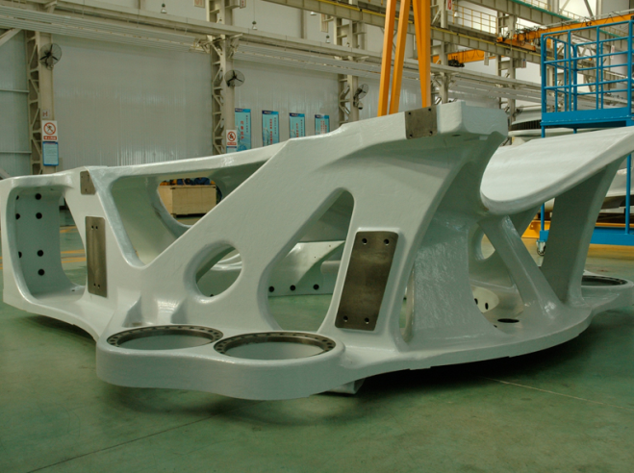
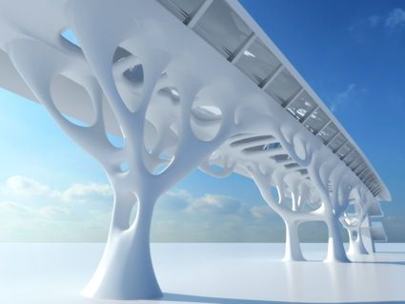
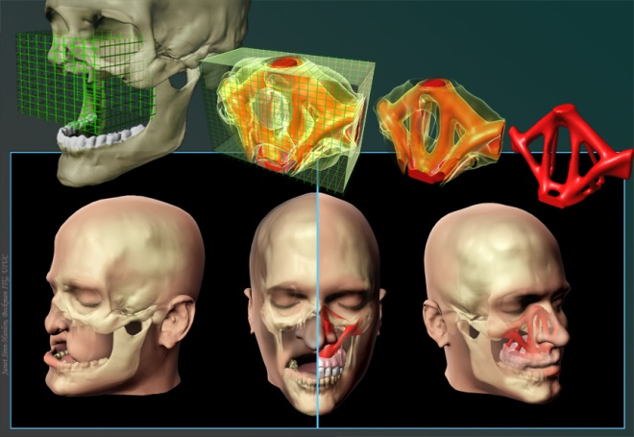
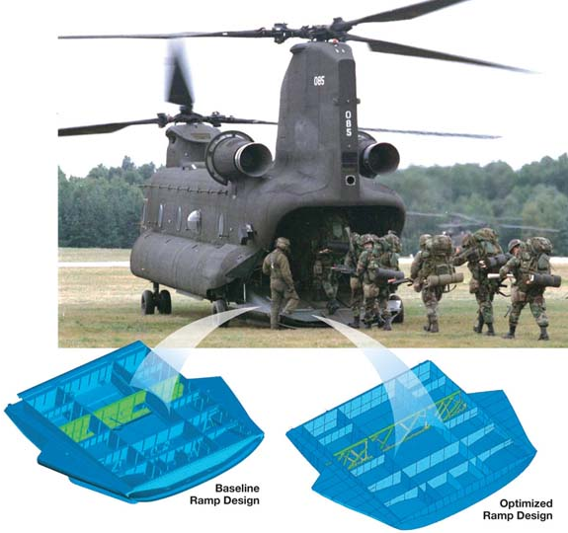
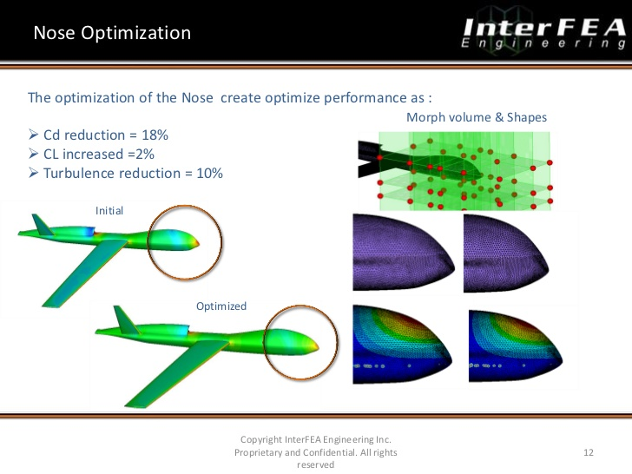
Topology optimization
Topology optimization = formulation of optimization problem + physics / mechanics
Cast structure for a wind turbine.
Architectural structure with an organic design.
Model custom bone replacement implants for facial reconstruction surgery.
10% reduction in turbulence by optimizing nose of drone.
Baseline ramp design
Optimized ramp design
Notes:
Motivating slides:
What is topology optimization?
Examples.
Focus: material and components optimization.

Slide 4
Topology optimization
Topology optimization is an inverse problem.
Find a realizable distribution and geometry of materials and components with desired functionality.
i.e. Minimize a target value via configuring the material layout in some design domain.
Computational approach:
Optimization model
Design model
Fabrication model
Analysis model
Parametrization and shape control.
Design variables definition.
Formulation of optimization problem.
Search strategy.
Multiscale and multiphysics analysis.
Fabrication constraints and costs.

Slide 5
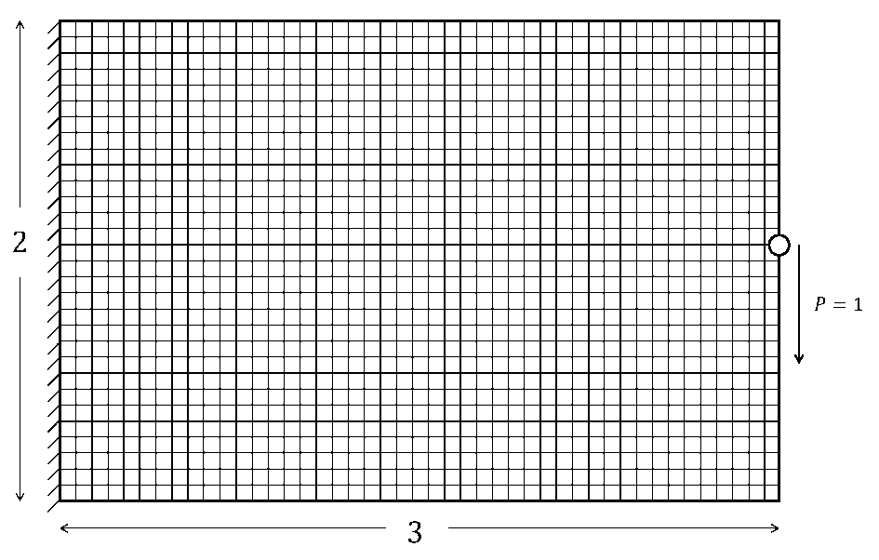
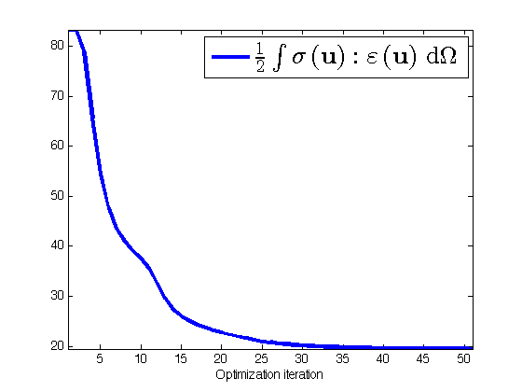
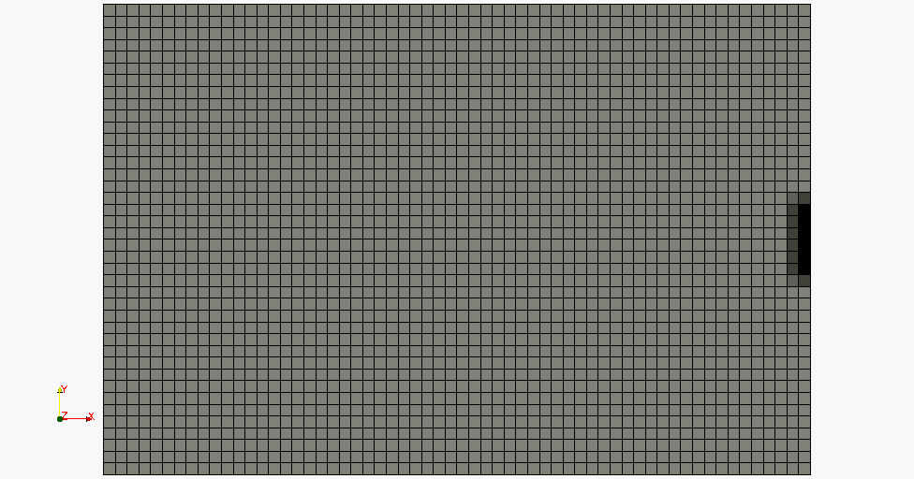
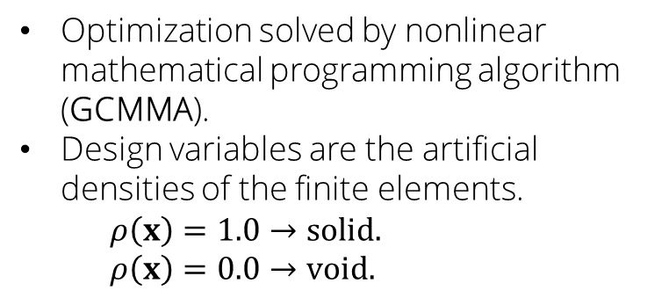
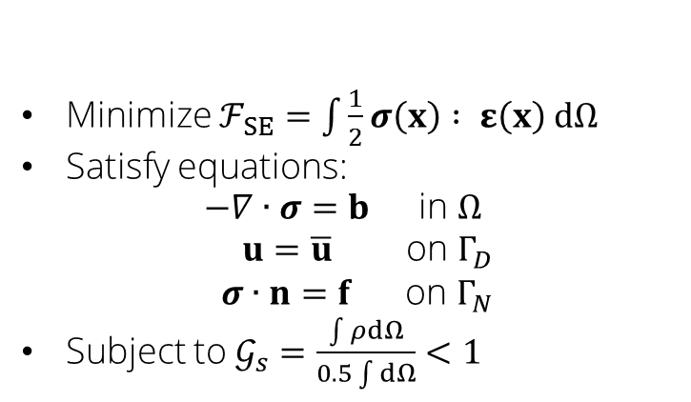
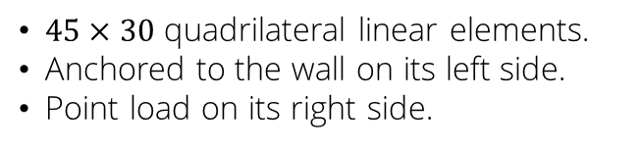
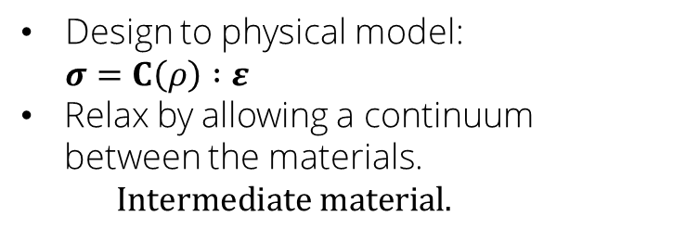
Structural topology optimization
Minimize $ℱ_{SE}=\int{\frac{1}{2}}σ\left(x\right) : ε\left(x\right) dΩ$
Satisfy equations:
$$\begin{matrix}−∇∙σ=b & \text{in} Ω \\ u=\overline{u} & \text{on} Γ_{D} \\ σ∙n=f & \text{on} Γ_{N}\end{matrix}$$
Subject to $𝒢_{s}=\frac{\int{ρd}Ω}{0.5\int{d}Ω}<1$
Optimization solved by nonlinear mathematical programming algorithm (GCMMA).
Design variables are the artificial densities of the finite elements.
$$ρ\left(x\right)=1.0→solid.$$
$$ρ\left(x\right)=0.0→void.$$
$45×30$ quadrilateral linear elements.
Anchored to the wall on its left side.
Point load on its right side.
Design to physical model:
$$σ=C\left(ρ\right) :ε$$
Relax by allowing a continuum between the materials.
$$Intermediate material.$$
Optimized geometry

Slide 6
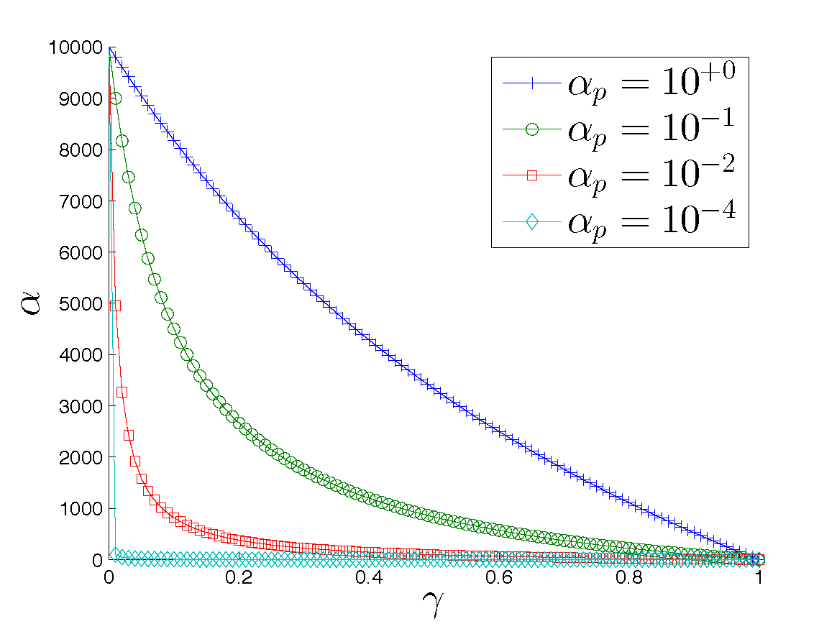
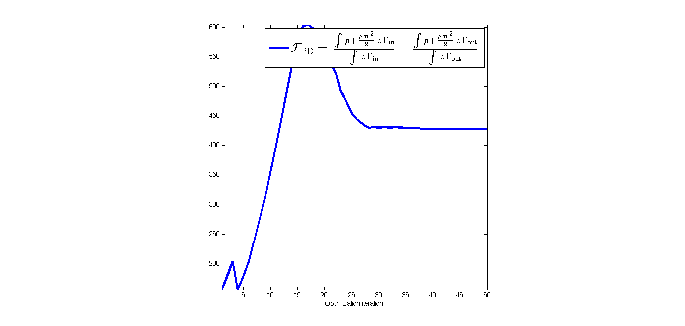
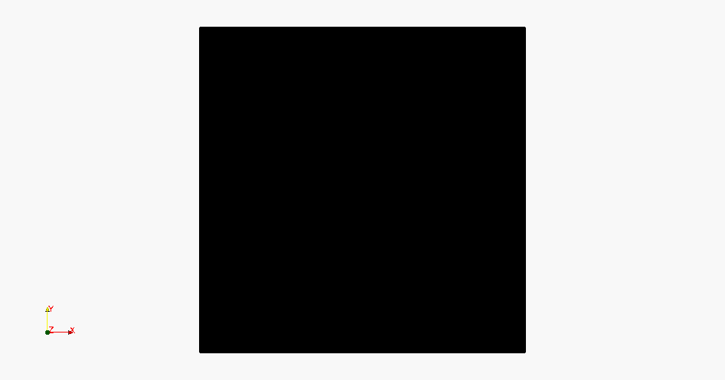
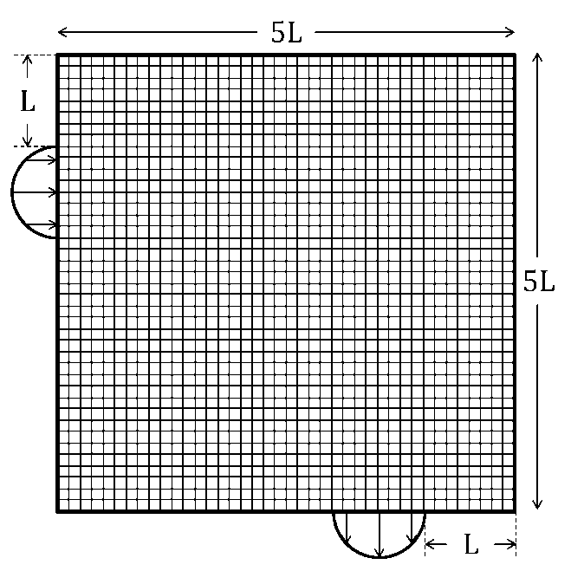
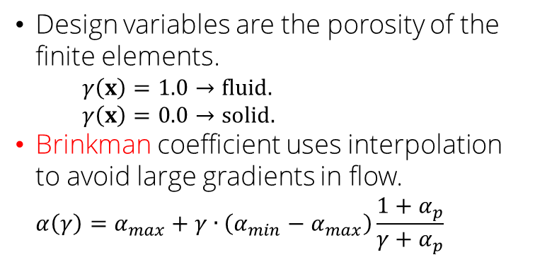
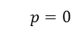
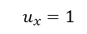
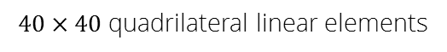
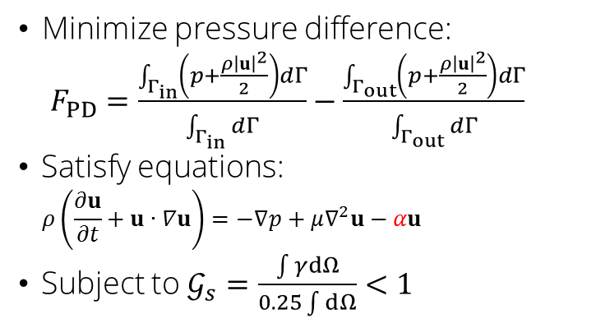
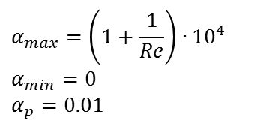
Incompressible Navier-Stokes flow topology optimization
Minimize pressure difference:
$F_{PD}=\frac{\int_{Γ_{in}}{\left(p+\frac{ρ{\left|u\right|}^{2}}{2}\right)dΓ}}{\int_{Γ_{in}}{dΓ}}−\frac{\int_{Γ_{out}}{\left(p+\frac{ρ{\left|u\right|}^{2}}{2}\right)dΓ}}{\int_{Γ_{out}}{dΓ}}$
Satisfy equations:
$$ρ\left(\frac{∂u}{∂t}+u∙∇u\right)=−∇p+μ∇^{2}u−αu$$
Subject to $𝒢_{s}=\frac{\int{γd}Ω}{0.25\int{d}Ω}<1$
Design variables are the porosity of the finite elements.
$$γ\left(x\right)=1.0→fluid.$$
$$γ\left(x\right)=0.0→solid.$$
Brinkman coefficient uses interpolation to avoid large gradients in flow.
$$α\left(γ\right)=α_{max}+γ∙\left(α_{min}−α_{max}\right)\frac{1+α_{p}}{γ+α_{p}}$$
$$u_{x}=1$$
$$α_{max}=\left(1+\frac{1}{Re}\right)∙{10}^{4}$$
$$α_{min}=0$$
$$α_{p}=0.01$$
$$p=0$$
$40×40$ quadrilateral linear elements
Optimized geometry.

Slide 7
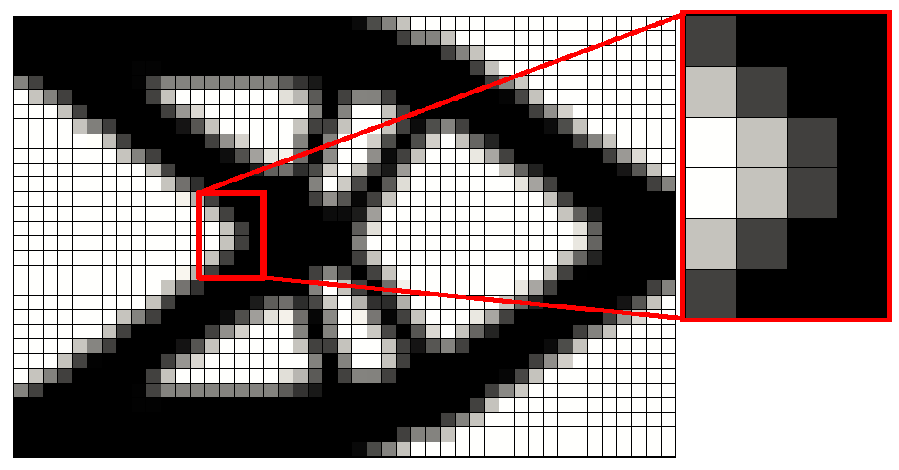
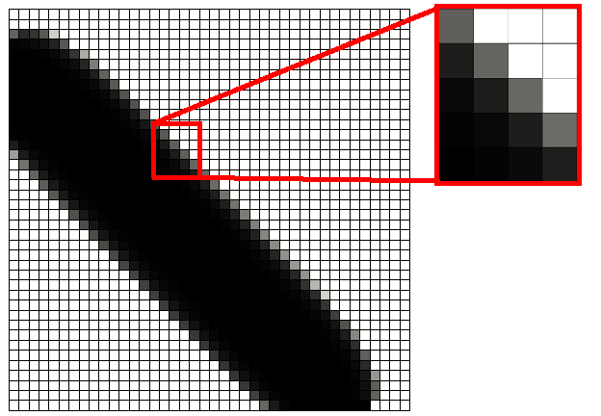
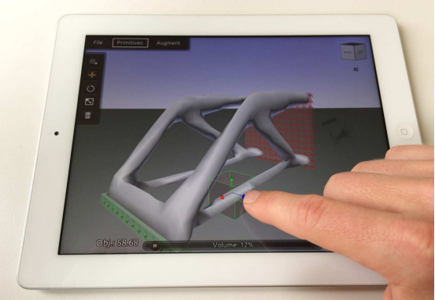
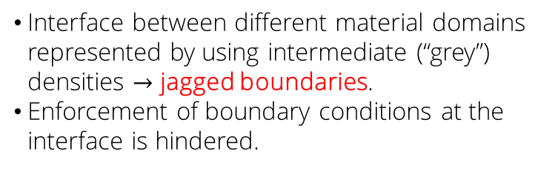
Density optimization methods
Jagged boundaries cause:
Premature yielding in structural mechanics due to stress singularities (Maute et al., 1998).
Fluid flow penetrating solid material in low Reynolds number flow (Kreissl and Maute, 2011) .
Scalar fields diffusing through solid material at low Péclet number flow (Makhija et al., 2012).
Especially in nonlinear problems.
These problems can be overcome by adaptive remeshing.
Expensive for three dimensional problems.
Density methods implemented in most commercial software; apps on iOS.
Interface between different material domains represented by using intermediate (“grey”) densities $→$ jagged boundaries.
Enforcement of boundary conditions at the interface is hindered.

Slide 8
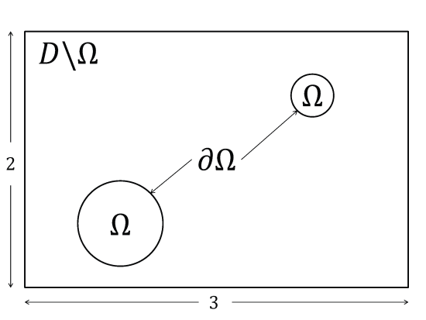
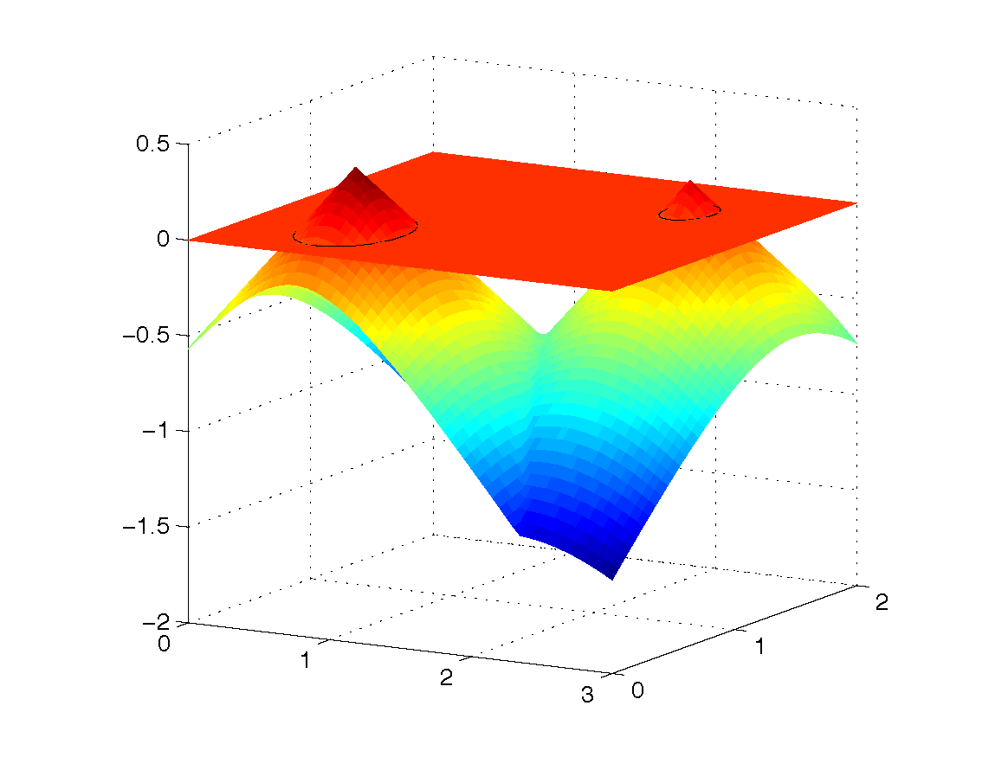
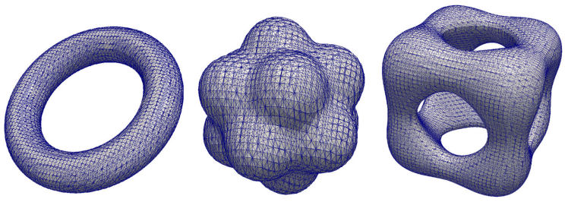
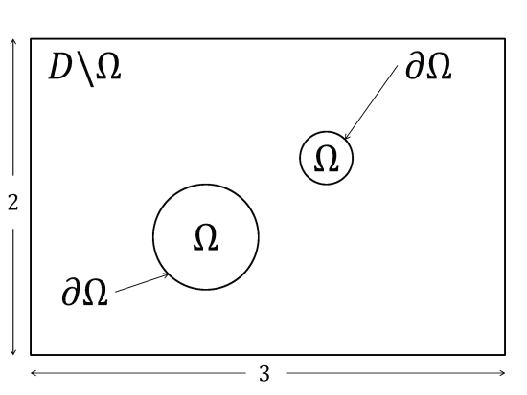
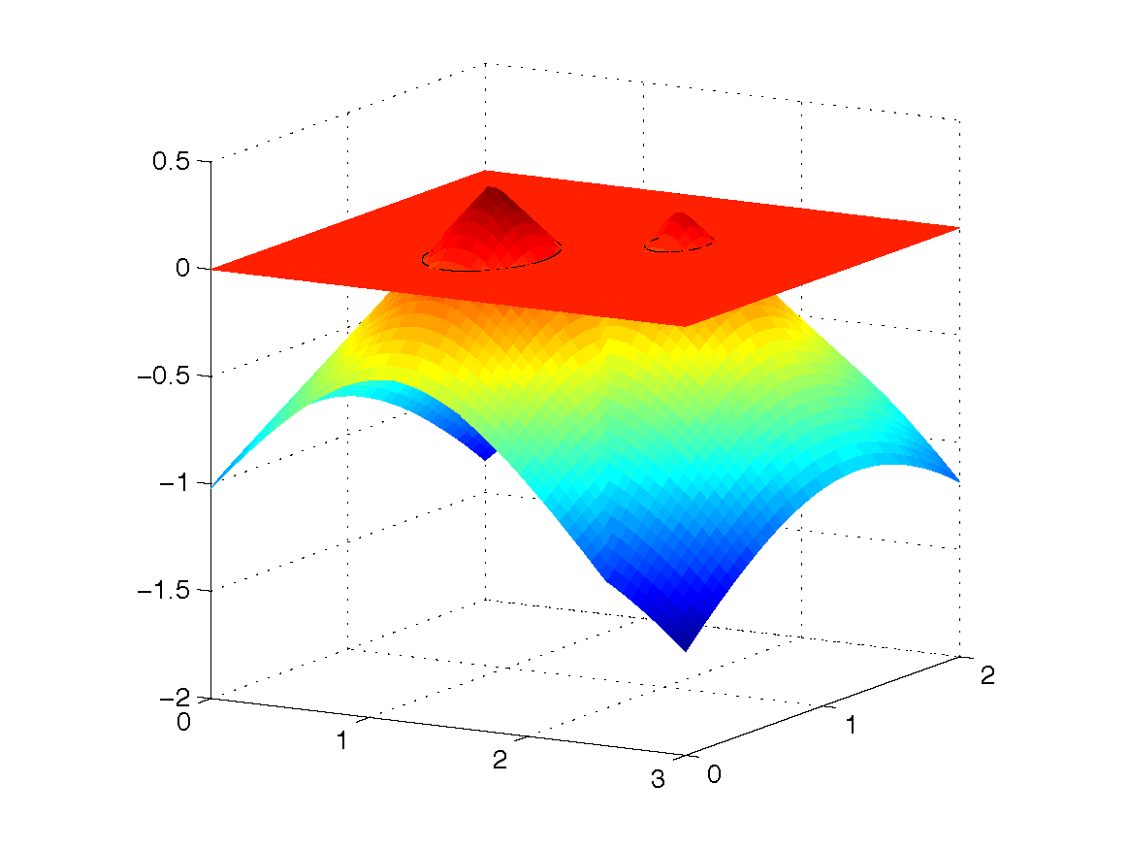
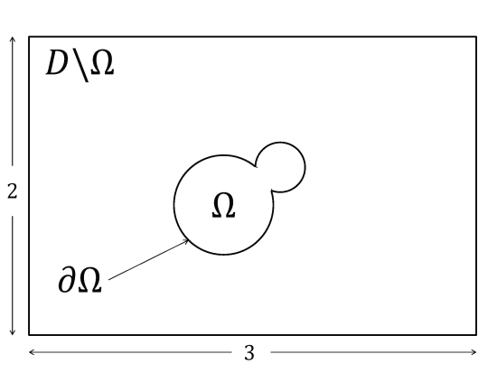
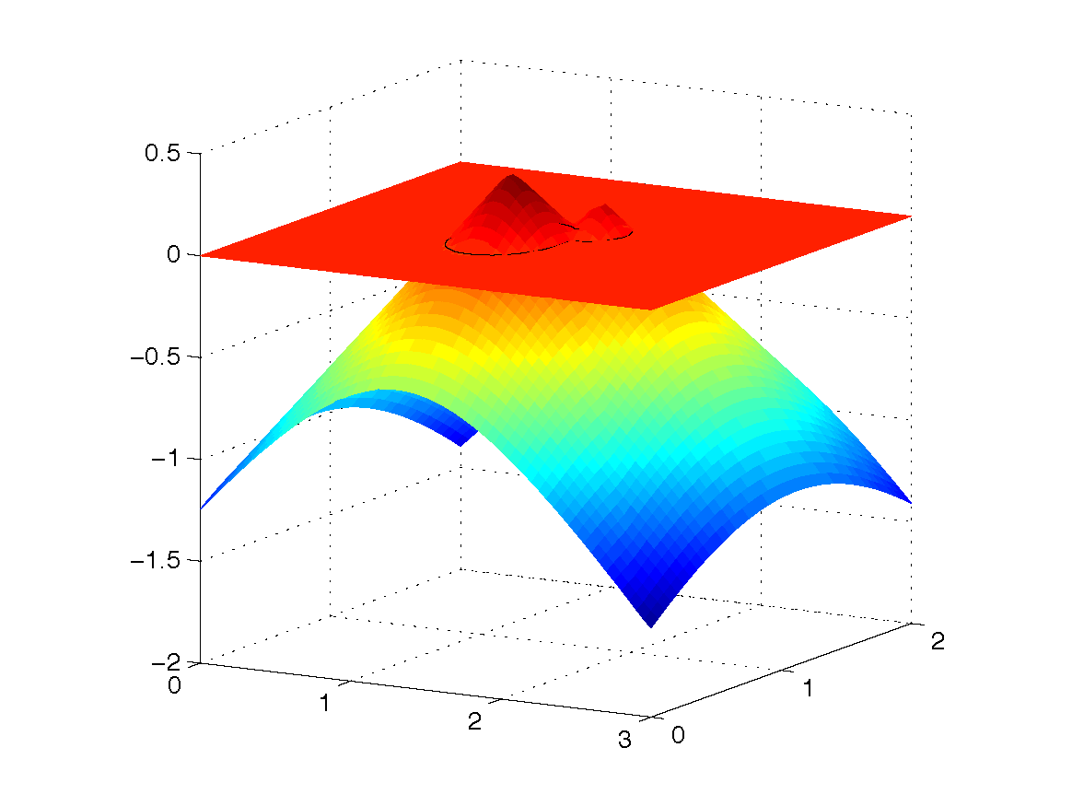
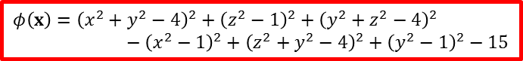
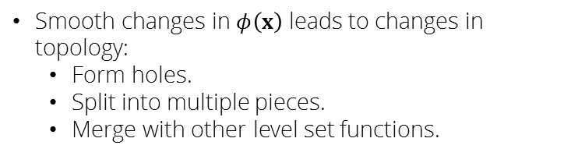
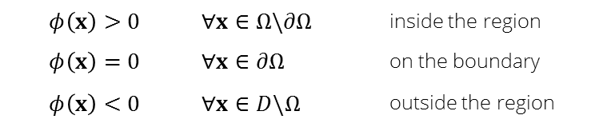
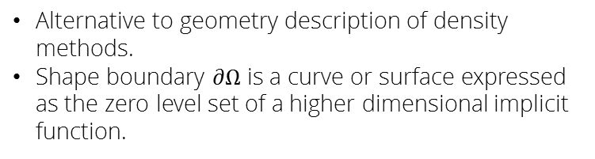
Level set method
Alternative to geometry description of density methods.
Shape boundary $∂Ω$ is a curve or surface expressed as the zero level set of a higher dimensional implicit function.
$$φ\left(x\right)={\left(x^{2}+y^{2}−4\right)}^{2}+{\left(z^{2}−1\right)}^{2}+{\left(y^{2}+z^{2}−4\right)}^{2}−{\left(x^{2}−1\right)}^{2}+{\left(z^{2}+y^{2}−4\right)}^{2}+{\left(y^{2}−1\right)}^{2}−15$$
Smooth changes in $φ\left(x\right)$ leads to changes in topology:
Form holes.
Split into multiple pieces.
Merge with other level set functions.
$$φ\left(x\right)>0$$ | $$∀x∈Ω\backslash ∂Ω$$ | inside the region
$$φ\left(x\right)=0$$ | $$∀x∈∂Ω$$ | on the boundary
$$φ\left(x\right)<0$$ | $$∀x∈D\backslash Ω$$ | outside the region

Slide 9
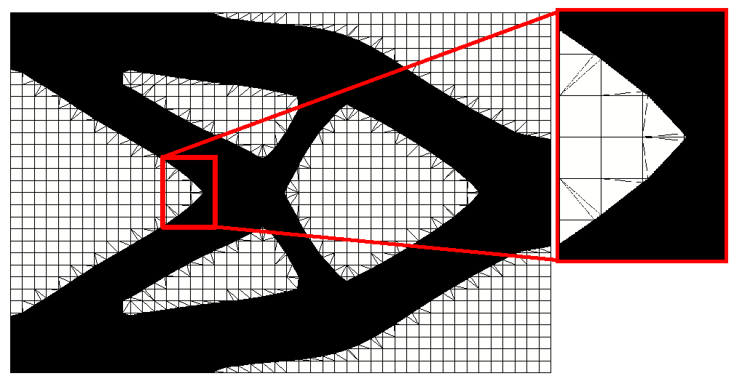
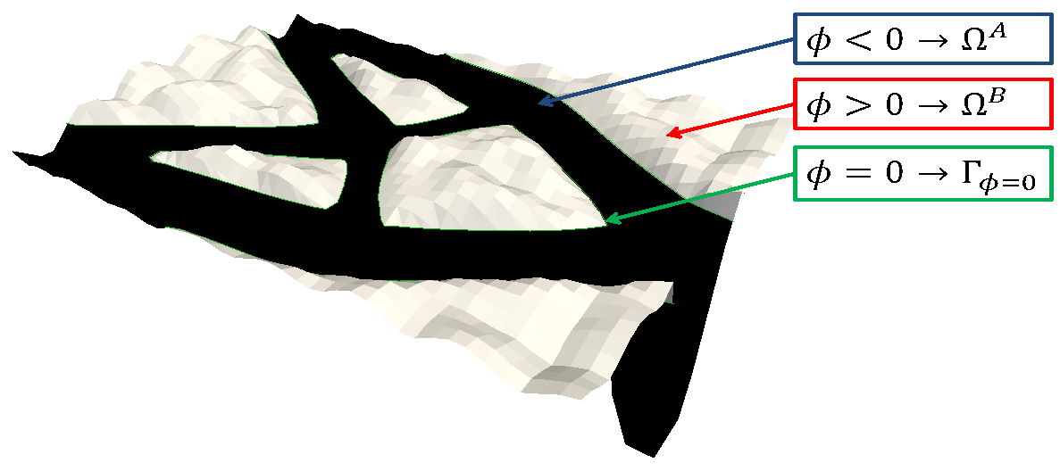
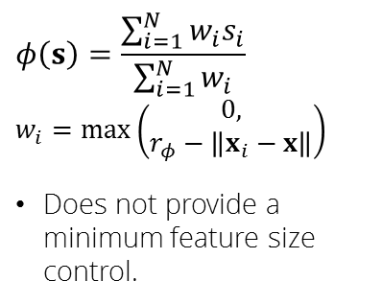
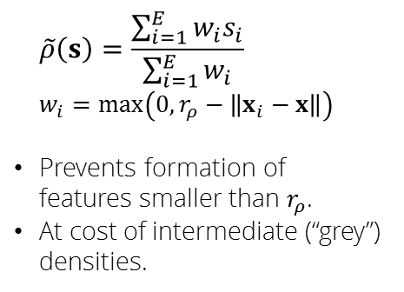
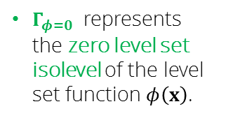
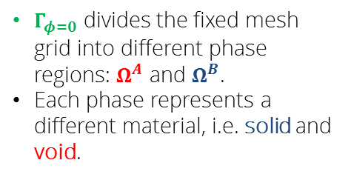
Geometry representation comparison: density and level set
Design variables, $s\left(x\right)$, are associated with nodes in these examples.
Density method
Level set method
$$φ\left(s\right)=\frac{\sum_{i=1}^{N}{w_{i}s_{i}}}{\sum_{i=1}^{N}{w_{i}}}$$
$$w_{i}=\max_{}\left(\begin{aligned}0, \\ r_{φ}−\left\|x_{i}−x\right\|\end{aligned}\right)$$
Does not provide a minimum feature size control.
$$\tilde{ρ}\left(s\right)=\frac{\sum_{i=1}^{E}{w_{i}s_{i}}}{\sum_{i=1}^{E}{w_{i}}}$$
$$w_{i}=\max_{}\left(0,r_{ρ}−\left\|x_{i}−x\right\|\right)$$
Prevents formation of features smaller than $r_{ρ}$.
At cost of intermediate (“grey”) densities.
$Γ_{φ=0}$ divides the fixed mesh grid into different phase regions: $Ω^{A}$ and $Ω^{B}$.
Each phase represents a different material, i.e. solid and void.
$Γ_{φ=0}$ represents the zero level set isolevel of the level set function $φ\left(x\right)$.

Slide 10
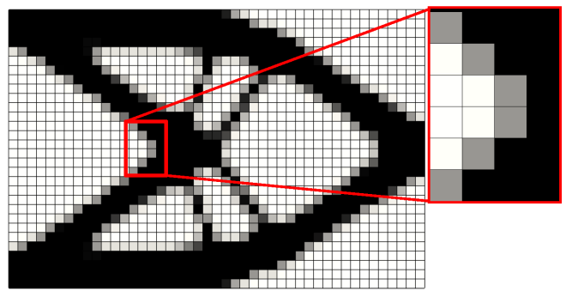

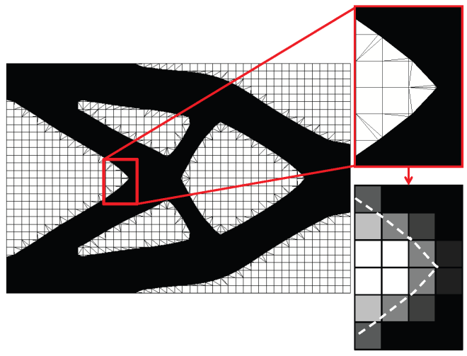
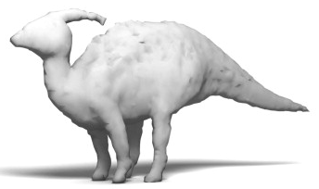
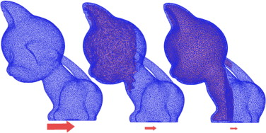
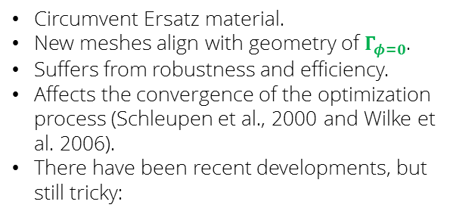
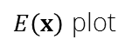
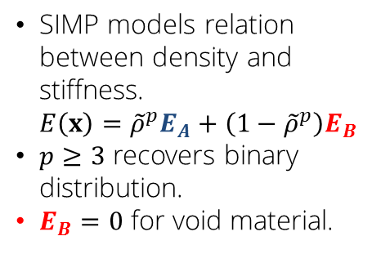
Material representation comparison: SIMP, Ersatz material, remeshing
Solid Isotropic Material with Penalization
Remeshing
SIMP models relation between density and stiffness.
$$E\left(x\right)={\tilde{ρ}}^{p}E_{A}+\left(1−{\tilde{ρ}}^{p}\right)E_{B}$$
$p≥3$ recovers binary distribution.
$E_{B}=0$ for void material.
$E\left(x\right)$ plot
Circumvent Ersatz material.
New meshes align with geometry of $Γ_{φ=0}$.
Suffers from robustness and efficiency.
Affects the convergence of the optimization process (Schleupen et al., 2000 and Wilke et al. 2006).
There have been recent developments, but still tricky:
Ersatz material
The material properties of each finite element are interpolated proportional to the volumes of the solid and void phases.
Similar issues as density methods.
Toy models optimized with remeshing to improve balance while maintaining the initial shape.

Slide 11








Material representation: eXtended Finite Element Method
Immersed boundary technique.
Decomposes finite elements into subdomains and interfaces for integration.
Enriches solution space, allowing for discontinuities.
Decomposition examples for 2D finite elements.
Gaussian quadrature points.
$$O→Ω_{tri}$$
$$× →Γ_{φ=0}$$
$$u\left(x\right)$$
$$u\left(x\right)$$
Solution approximation by standard enrichment.
$$u\left(x\right)=H\left(−φ\right)\sum_{i=1}^{n}{N_{i}u_{i}^{A}}+H\left(φ\right)\sum_{i=1}^{n}{N_{i}u_{i}^{B}}$$
$$H\left(z\right)=\left\{\begin{aligned}1, z<0 \\ &0, z≥0\end{aligned}\right.$$
Kinks
Jumps

Slide 12

The LSM-XFEM framework
Design variables mapped to a $φ\left(x\right)$.
LSF discretized by finite elements.
Regularization?
LSF parametrization
Physical model
Geometry mapping
Discretized PDE
XFEM.
Generalized enrichment strategy.
Stab. Lagrange, Nitsche, ghost penalty.
Preconditioner.
Optimization model
Sensitivities
Update procedure
Adjoint method.
Solved by Nonlinear Programming Methods.
GCMMA.

Slide 13
Overview
Introduction.
Goals and objectives.
Case studies.
Structural linear elasticity.
Incompressible Navier-Stokes flow with scalar transport.
Curvature.
Incompressible Navier-Stokes with multiple scalar fields.
Conclusions.

Slide 14
Goals and hypotheses

Slide 15

Goals and objectives
Generate a generic, robust, and efficient LSM-XFEM topology optimization framework.
Generic:
Develop a generic optimization approach.
LSM-XFEM can be used for different physics.
In contrast with density methods.
Requires a different interpolation scheme for each physics.
Structural linear elasticity: $E\left(x\right)={\tilde{ρ}}^{p}E_{A}+\left(1−{\tilde{ρ}}^{p}\right)E_{B}$
Incompressible Navier-Stokes: $α\left(γ\right)=α_{max}+γ∙\left(α_{min}−α_{max}\right)\frac{1+α_{p}}{γ+α_{p}}$
LSM-XFEM can be used for 2D and 3D problems.
LSM-XFEM can be used for multi-material problems.
Robust:
Material interpolation in SIMP is robust for linear problems.
Not as accurate in nonlinear problems.
Apply to linear and nonlinear problems.
Study shape control capabilities.
Study boundary condition enforcement at phase interface.
Efficiency:
Study computational cost.
Mesh size requirements.

Slide 16
Goals and objectives
Compare the LSM-XFEM optimization scheme with traditional density methods.
Study the advantages and disadvantages.
Explore characteristics of framework through case studies:
Structural linear elasticity,
Incompressible Navier-Stokes flow.
Scalar transport.
Real-world incompressible Navier-Stokes with multiple scalar fields transport problem.
Each one of them requires special treatment in density method.
Two “material–void” and “material–material” problems.
Three dimensional.
Help understand the characteristics and capabilities of the framework.

Slide 17
Case study I
Structural topology optimization

Slide 18


Goals and objectives
Objective:
Implement algorithms for LSM-XFEM framework in 3D.
Compare LSM-XFEM framework against density methods, such as SIMP, with a structural linear elastic problem.
Hypotheses:
Requires coarser meshes which may lead to faster computations.
Provides ability to extract surface meshes from level set function to manufacture design.
Open issues:
Comparison against density methods*.
Convergence rates?*
Shape control?*
Postprocessing for manufacturing?*
Influence of initial design?*
*for selected case studies.

Slide 19

Issue: XFEM implementation in three dimensions
Objective:
Expand the triangulation, enrichment, and preconditioner formulations to 3D.
Open issues:
What is the algorithmic complexity?
Use computer vision algorithms to “see” disconnected phase regions?
How expensive is it computationally?
Intersection pattern can be numerous and complex in three dimensions.

Slide 20



Approach: generalized enrichment strategy for 3D XFEM
Grounded on flood fill computer vision algorithm.
Several implementation algorithms attempted.
Latest version reduced computation time from ~10 minutes on average to milliseconds.
Intersection configuration
Local elemental enrichment
Nodal cluster enrichment

Slide 21






Issue: generalized description of discontinuities
Two dimensional structural linear elastic problem with four quadrilateral elements.
Multiple disconnected regions of the same phase may appear during optimization.
Approach:
Augments the standard function space with additional “enriched” degrees-of-freedom.
Heaviside enrichment formulation of Hansbo and Hansbo (2004).
$$u\left(x\right)=\sum_{m=1}^{M}{\left(H\left(−φ\right)\sum_{i=1}^{n}{N_{i}u_{i,m}^{A}}+H\left(φ\right)\sum_{i=1}^{n}{N_{i}u_{i,m}^{B}}\right)}$$
Phase “A” |  | Phase “B”
$$u_{x_{0}}^{A}$$ | $$u_{x_{0}}^{A}$$ | $$u_{x_{0}}^{B}$$ | $$u_{x_{0}}^{B}$$
$$u_{x_{1}}^{A}$$ | $$u_{x_{1}}^{A}$$ | $$u_{x_{1}}^{B}$$ | $$u_{x_{1}}^{B}$$
$$u_{x_{2}}^{A}$$ | $$u_{x_{2}}^{A}$$ | $$u_{x_{2}}^{B}$$ | $$u_{x_{2}}^{B}$$
$$u_{x_{3}}^{A}$$ | $$u_{x_{3}}^{A}$$ | $$u_{x_{3}}^{B}$$ | $$u_{x_{3}}^{B}$$
$$u_{x_{4}}^{A}$$ | $$u_{x_{4}}^{A}$$ | $$u_{x_{4}}^{B}$$ | $$u_{x_{4}}^{B}$$
Center node uses different dofs to describe disconnected phase regions.
Subscripts denote the $m$ enrichment level.
Maximum number of enrichment levels for each phase $M=5$.
$$m$$ | : | Enrichment level.
$$M$$ | : | Maximum number of enrichment levels for each phase.
$$u_{i,m}^{l}$$ | : | Vector of degrees-of-freedom.
$$l=[A,B]$$ | : | Phase region.
$∎$ Active for phase “A”.
$∎$ Active for phase “B”.
$∎$ Inactive.
Notes:
Adaptive mesh refinement also resolves artificial stiffening issue, but it is less attractive for topology optimization.

Slide 22






Issue: Ill-conditioned analysis problems
Changes in topology may cause vanishing zone of influence for certain degrees-of-freedom. 
Ill-conditioning is more pronounced in 3D (more intersection patterns).
Approach:
Balance the influence of all degrees of freedom in the system (Lang et a., 2013).
$$T_{i,m}^{l}={\left(\max_{e∈E_{i}}{\frac{\int_{Ω_{e,m}^{l}}{∇N_{i}\left(x\right)∙∇N_{i}\left(x\right)dx}}{\int_{Ω_{e}^{}}{∇N_{i}\left(x\right)∙∇N_{i}\left(x\right)dx}}}\right)}^{−1/2}$$
$$E_{i}$$ | : | Set of elements connected to node $i.$
$$Ω_{e,m}^{l}$$ | : | Element domain of phase $l$.
Constraint degrees-of-freedom
$$T_{i,m}^{l}>T_{tol}$$
Example of vanishing zone of influence for $u_{x_{1}}^{B}$ and $u_{x_{1}}^{B}$.
The condition number of the stiffness matrix increases. 
Preconditioner expanded to 3D and built upon enrichment information.

Slide 23





Issue: Ensure continuity of solution at phase boundary $Γ_{φ=0}$
$$u\left(x\right)$$
$$u\left(x\right)$$
The Heaviside function allows for discontinuities of the states $u$ along the phase boundaries.
Kinks
Jumps
Hypothesis:
Can we accurately enforce boundary conditions on the phase interface without extensive mesh refinement?
Can we ensure continuity of solution? $u^{A}=u^{B} on Γ_{φ=0}$ for “material-material” problems.
Approach:
Stabilized Lagrange multipliers.
$$\int_{φ=0}{δλ∙\left(λ−\left(\frac{1}{2}\left(σ^{A}+σ^{B}\right)\right)∙n_{Γ_{φ=0}}\right)dΓ}−\int_{φ=0}{δλ∙\left(u^{A}−u^{B}\right)dΓ}−\int_{φ=0}{δ\left(u^{A}−u^{B}\right)∙λdΓ}$$
Nitsche method (penalty enforcement).
Proper treatment of interface conditions is key to obtaining accurate solution gradient along interface. 
Notes:
Note that the standard Lagrange multiplier approach is not suitable for the XFEM as it suffers from numerical instabilities.

Slide 24





Issue: Controlling the shape of the level set function
Motivation:
Emergence of numerical artifacts in optimization problem.
Convergence to local minima.
Minimize $ℱ_{SE}$
Minimize $ℱ_{SE}+ℱ_{P}$
Hypothesis:
We can control the shape of the design through regularization techniques.
Objective:
Use regularization technique to:
Avoid local minima with poor performance.
Control geometrical properties.
Open issues:
What are the effects of applying a perimeter constraint in 3D?
Does it provide local shape control? e.g. minimum feature size?
$$ℱ_{P}=\int_{φ=0}{dΓ}$$
Perimeter
$$ℱ_{n}=\int_{φ=0}{∇∙n dΓ}$$
Curvature

Slide 25


Issue: Emergence of numerical geometrical artifacts
For “solid-void” problems, designs with free floating pieces of material may be generated in the course of the optimization process.
Causes ill-conditioning of the system.
Approach:
Adding soft springs between every material point and a fictitious support.
$$\int{k_{A}N∙udΩ^{A}}$$
$k_{A}$ denotes the stiffness of the distributed system of springs, ${10}^{−6}$, for all examples.
Minimize perimeter of $Γ_{φ=0}$ with $ℱ_{P}$.

Slide 26








Convergence rate / feature size control
Minimize $ℱ_{SE}(+ℱ_{P})$
Maximum stiffness for given mass $10\%$
$r_{ρ}=r_{φ}=1.6∙h$
$65×65×65$
Issue:
Design sensitivities differ from zero near the interface.
No new domains of solid can emerge, only possible to merge existing.
Approach:
Seeding the initial design with several void areas.
SIMP
LSM-XFEM
$$ℱ_{SE}=3.5519×{10}^{−2}$$
$$ℱ_{SE}=3.5244×{10}^{−2}$$
No issues with minimum feature size.
Strain energies are similar.
Convergence is faster.

Slide 27















SIMP and XFEM comparison: Mesh convergence
SIMP
$$ℱ_{SE}=2.6555×{10}^{3}$$
$$40×10×10$$
$$60×15×15$$
$$80×20×20$$
$$120×30×30$$
$$ℱ_{SE}=9.8262×{10}^{2}$$
SIMP design changes with mesh refinement because of $r_{ρ}$.
In XFEM, only local details are improved.
LSM-XFEM
Minimize $ℱ_{SE}(+ℱ_{P})$
Maximum stiffness for given mass $10\%$
$r_{ρ}=r_{φ}=1.6∙h$

Slide 28






Smoothing filter / feature size control
$$120×30×30$$
SIMP approach leads to the same layout for a mesh independent filter.
Increasing $r_{φ}$ results in a less smooth design.
$r_{φ}$ does not control shape.
SIMP
LSM-XFEM
$$r_{ρ}=0.16$$
$$r_{φ}=0.16$$

Slide 29




Initial design / feature size control
$$120×30×30$$
Constrain the perimeter $𝒢_{P}$ using perimeter from SIMP.
Open issues:
Neither perimeter constraint nor smoothing control the local feature size.
Effect of a perimeter constraint is non-intuitive.
Approach:
A minimum feature size control approach is outside the scope of this work.
LSM-XFEM restarted from SIMP design.
LSM-XFEM restarted from XFEM design.

Slide 30









Two-phase problem / manufacturing
Manufacturing example of a two-phase “solid-solid” problem using 3D printing.
How do we extract optimized geometries from the design domain?
SIMP
$$\frac{E^{A}}{E^{B}}=0.5$$
$$\frac{E^{A}}{E^{B}}=0.1$$
$$\frac{E^{A}}{E^{B}}=0.01$$
$$E^{b}=void$$
Minimize $ℱ_{SE}(+ℱ_{P})$
Maximum stiffness for given mass $30\%$
$r_{ρ}=r_{φ}=1.6∙h$
$120×30×30$
Extract surface through isolevels of $ρ$.
Choosing correct value of $ρ$ not trivial.
LSM-XFEM
Extract threshold of subdomains for specific region.

Slide 31
Case Study II
Incompressible Navier-Stokes and scalar transport

Slide 32
Goals and objectives
Study the characteristics of the LSM-XFEM framework for three dimensional incompressible Navier-Stokes flow and scalar transport problems.
Enforcement of boundary conditions at the phase interface for high Reynolds number flow.
Motivation:
Density methods in fluids, such as the Brinkman penalization cause spurious pressure diffusion through solid material.
Approach:
LSM-XFEM framework.
Stabilized Lagrange multipliers.

Slide 33







Pipebend and diffuser
“Fluid-solid” problem.
Minimize $ℱ_{PD}$.
Maximum volume fraction of fluid phase 25% and 50%.
$Re=1.0$
$r_{φ}=2.4∙h$
Pipebend
Diffuser
Initial designs.
Fluid
Solid
Fluid
Solid

Slide 34





Pipebend and diffuser
Identical results for Stokes and Navier-Stokes formulation with $Re=1.0$.
Open issues:
Higher $Re$ flow does not converge for certain topologies.
Oscillations occur near interface.
Approach:
Explore Nitsche method for enforcing continuity at interface.
Use face-oriented ghost penalty to increase stability.

Slide 35




Approach: Face-oriented ghost-penalty
Objective:
Overcome stability issues on cut elements for viscous flows.
Control higher-order derivatives on a cut element.
Method used for single enrichment diffusion and incompressible Navier –Stokes flow (Burman and Hansbo, 2012; Schott et al., 2014).
Hypothesis:
Smoothing the gradient of the solution across the element facets reduces condition number.
Open issues:
Expand methodology to 3D.
Apply method in topology optimization.
With multiple enrichment functions.
For incompressible Navier-Stokes:
$$\sum_{l∈\left\{A,B\right\}}{\sum_{m=1}^{M}{\sum_{F∈{ℱ_{G}}_{m}^{k}}{\sum_{i=1}^{D}{\int_{F}{α_{GP,μ}μ^{l}h_{F}^{2\left(i−1\right)+1}\left[\frac{∂^{i}N}{{∂x}^{i}}\right]∙n_{F}:\left[\frac{∂^{i}u_{m}^{l}}{{∂x}^{i}}\right]∙n_{F} ds}}}}}+\sum_{l∈\left\{A,B\right\}}{\sum_{m=1}^{M}{\sum_{F∈{ℱ_{G}}_{m}^{k}}{\sum_{i=1}^{D}{\int_{F}{α_{GP,μ}{μ^{l}}^{−1}h_{F}^{2i+1}\left[\frac{∂^{i}N}{{∂x}^{i}}\right]∙n_{F}:\left[\frac{∂^{i}p_{m}^{l}}{{∂x}^{i}}\right]∙n_{F} ds}}}}}$$

Slide 36









Micromixer
Fluid region
Temperature
Minimize:
$$ℱ_{TSV}=\frac{1}{β}ln\left(\int_{Γ}{e^{β{(T−T_{ref})}^{2}}dΓ}\right)$$
Maximum volume fraction of fluid phase 50%.
$Re=1.0$
$r_{φ}=2.4∙h$
Open issues:
Same as issues as pipebend and diffuser problems for higher $Re$. 
Top
Bottom
Streamlines
Identical results for Stokes and Navier-Stokes formulation with $Re=1.0$.

Slide 37
Case Study III
Curvature regularization

Slide 38

Goals and objectives
Issues:
Can we get rid of floating particles and rough surfaces without a perimeter penalty/constraint?
To avoid losing wavy pattern.
Approach:
Include smoothness measure in optimization problem.
To control optimization parameters.
How do we measure smoothness?
Curvature measures how much the normal unit vector changes as we move along a curve.
$$κ=\left\|\frac{dn}{ds}\right\|$$
Image recognition community minimizes squared curvature to smooth images.
Measuring curvature along $Γ_{φ=0}$.
$$ℱ_{κ}=\int_{φ=0}{{\left(∇∙n\right)}^{2} dΓ}=\int_{φ=0}{{\left\|\frac{dn}{ds}\right\|}^{2}dΓ}$$
Objective:
Control the smoothness of the level set interface without creating flat designs.
Smooth surface meshes are important for manufacturing.
Notes:
Control the smoothness of the level set interface without creating flat designs.
Smooth surface meshes are important for manufacturing.

Slide 39





















How do we measure $n$?
$$n_{φ}$$
$$n_{u}$$
$$n_{g}$$
Enforced in the strong form with $N$.
$$n_{φ}=\frac{∇φ}{\left\|∇φ\right\|}$$
Enforced in the weak form.
$$\int_{Ω}{δn_{u}\left(n_{u}\left\|∇φ\right\|−∇φ\right) dΩ}=0$$
Model interface as structural linear beam elements.
$$ℱ_{κ}=\int_{φ=0}{{\left\|\frac{dn}{ds}\right\|}^{2}dΓ}=\frac{1}{2}\int_{φ=0}{σ:ε}dΓ$$
Sinusoidal wave with an amplitude of $0.50$.
Mesh discretization is $45×30$ elements.
--- All cut elements within a radius $r_{κ}=0.4$.
$$n_{ψ}$$
Project $φ$ with hyperbolic tangent function.
$$ψ\left(φ\right)=\frac{1}{2}\left(\tanh\left(\frac{φ}{2ε}\right)+1\right)$$
Enforce in the weak form.
$$\int_{Ω}{δn_{ψ}\left(n_{ψ}\left\|∇ψ\right\|−∇ψ\right) dΩ}=0$$
$$φ$$
Inner nodes have two rotational degrees-of-freedom.
Artificial springs allow intersection points to displace to their analytical location.
$$ε=1.0$$
$$ε=2.0$$
$$ε=4.0$$
Continuity in the internal rotational degrees-of-freedom with Lagrange multipliers.
$$θ_{z}^{L}−θ_{z}^{R}=α_{CR}$$
Open issues:
What is the influence of computing $n$ from the interface vs. geometrically on the smoothness measure?

Slide 40






Preliminary results
Minimize $ℱ_{SE}+ℱ_{κ}$ using $n_{u}$
Minimize $ℱ_{SE}+ℱ_{κ}$ using $n_{g}$
$ℱ_{κ}$ using $n_{u}$ yields a smooth design yet with a few kinks.
$ℱ_{κ}$ using $n_{g}$is computed directly at the intersection points.
Smoother results.
Open issues:
Too smooth? 
Penalize only sharp corners?

Slide 41
Case Study IV
Incompressible Navier-Stokes flow with multiple scalar fields

Slide 42


Atomic Layer Deposition
ALD is a thin film deposition technique in which two or more chemicals react with the surface of a material.
Issues:
Machine has open boundaries which may cause reactions with air.
Lead to imperfections in the deposition.
Approach:
Model an incompressible Navier-Stokes flow problem with multiple scalar transport fields.
Model interaction of multiple reactants with outside sources.
Holes at the top are inlets through which the chemical reactants enter.
Conveyor belt moves a web on which the chemicals are deposited.

Slide 43





Atomic Layer Deposition
Scalar transport equation:
$$\frac{∂c}{∂t}−u∙∇c−d∇^{2}c−q=0$$
where $c$ is the species concentration and $d$ is the diffusivity.
The inflow velocity of the inlets is:
$$u_{{inlet}_{z}}=1.0∗0.53\frac{m}{s}$$
Material properties:
$$ν_{N2}=1.52∙{10}^{−5}\frac{m^{2}}{s}$$
$$ρ_{N2}=1.16\frac{kg}{m^{3}}$$
$$d_{N2,H2O}=2∙{10}^{−5}\frac{m^{2}}{s}$$
Objective:
Expand our scalar transport model to simulate multiple scalar transport fields.
$$\frac{∂c}{∂t}−u∙∇c−d∇^{2}c−q=0$$
Research the interaction of the reactant with the outside sources, such as air.
Optimize the layout of the gas source heads.
Minimize mixing.
$$ℱ_{MX}=\int_{t}{\int_{Γ}{\sqrt[n]{{\left(\left(c−c_{1}\right)\left(−c+c_{2}\right)\right)}^{n}}}}dΓdt$$
where $c_{1}$ and $c_{2}$ are the concentration of the inlets.
$$y$$
$$x$$
Diffusion of gases

Slide 44
Conclusions

Slide 45
Conclusions
The LSM can describe the geometry and the XFEM can predict the structural response.
Built upon generalized enrichment and preconditioning schemes.
Applied method to:
Two “material–void” and “material–material” problems in 3D.
Structural linear elasticity.
Incompressible Navier-Stokes flow.
Scalar transport.

Slide 46

Is it generic?
Used the same optimization approach for:
Multiphysics problems.
Two-phase “material–void” and “material–material” problems.
2D and 3D problems.
LSM can describe complex geometries.
XFEM can model discontinuities with generalized enrichment strategy.

Slide 47
Is it efficient?
Method is significantly more complex in regards of implementation.
Similar assembly time for “material–void ” problems.
More time for “material–material” due to larger linear system.
Faster optimization convergence rate.
Ability to represent thin-walled structures on coarse meshes.
Enforce boundary conditions on coarse meshes.
Alternative to density methods for problems where a high mesh resolution is not tolerable.

Slide 48

Is it robust?
Perimeter and curvature provide global shape control.
Capability to mitigate numerical artifacts.
Method can be used in linear and nonlinear problems.
Open issues:
Smoothing filter and perimeter constraint do not control local feature size.
Outside the scope of this work.
Interface conditions need to be enforced accurately for higher $Re$ flow.
Using $n_{g}$ may yield too smooth designs.
Hypothesis:
Boundary conditions are not enforced accurately.
Small intersection regions cause ill-conditioning.
Stabilized Lagrange multipliers (to solve for $σ$ at $Γ_{φ=0}$) fail due to ill-conditioning.

Slide 49

Is it robust?
Remaining work:
Structural linear elasticity:
Study stress constrains with face-oriented ghost penalty in structural linear elasticity.
Incompressible Navier-Stokes with scalar transport:
Explore Nitsche method for enforcing continuity at interface in higher $Re$ flow
Explore face-oriented ghost penalty to increase stability in higher $Re$ flow.
Curvature regularization:
Study influence of $n$ in the smoothness measure.
Penalize intermediate curvatures to better control the shape.
Atomic layer deposition:
Expand our scalar transport model to simulate multiple scalar transport fields.
Research the interaction of the reactant with the outside sources, such as air.

Slide 50
Timeline
Need to complete this slide.

Slide 51
Bibliography
Hansbo A, Hansbo P (2004) A finite element method for the simulation of strong and weak discontinuities in solid mechanics. Computer methods in applied mechanics and engineering 193(33):3523-3540
Kreissl S, Pingen G, Maute K (2011) An explicit level set approach for generalized shape optimization of fluids with the lattice boltzmann method. International Journal for Numerical Methods in Fluids 65(5):496-519
Lang C, Makhija D, Doostan A, Maute K (2013) A simple and efficient preconditioning scheme for heaviside enriched XFEM. Computat Mech.
Makhija D, Pingen G, Yang R, Maute K (2012) Topology optimization of multicomponent flows using a multi-relaxation time lattice boltzmann method. Computers & Fluids 67(0):104-114
Maute K, Schwarz S, Ramm E (1998) Adaptive topology optimization of elastoplastic structures. Structural and Multidisciplinary Optimization 15(2):81-91
Schleupen A, Maute K, Ramm E (2000) Adaptive fe-procedures in shape optimization. Structural and Multidisciplinary Optimization 19:282-302
Wilke DN, Kok S, Groenwold AA (2006) A quadratically convergent unstructured remeshing strategy for shape optimization. International journal for numerical methods in engineering 65(1):1-17
Burman E, Hansbo P (2012) Fictitious domain nite element methods using cut elements: II. a stabilized Nitsche method. Applied Numerical Mathematics 62(4):328-341.
Schott B, Rasthofer U, Gravemeier V,WallW(2014) A face-oriented stabilized Nitsche-type extended variational multiscale method for incompressible two-phase ow. International Journal for Numerical Methods in Engineering.

Slide 52


